Slide 1

“Credentials, Profile Management for hiring sector and admin panel”
Project Guide : Prof. K. RAJESH RAO
MOHAMMED SAIF
1AZ15MCA05
6TH SEMESTER, MCA
AIT - BANGALORE

Slide 2
ABOUT THE COMPANY
Shru2 Softech Services Private Limited is a Private company incorporated on 13 February 2017. It is classified as Non-govt company and is registered at Registrar of Companies, Pune. Its authorized share capital is Rs. 10,00,000 and its paid up capital is Rs. 1,00,000.
It is involved in Other computer related activities [for example maintenance of websites of other firms/ creation of multimedia presentations for other firms etc.
Shru2 Softech Services Private Limited's Corporate Identification Number is (CIN) U72900PN2017PTC168879 and its registration number is 168879.

Slide 3
“Credentials, Profile Management for hiring sector and admin panel”
ABOUT THE PROJECT :
This project helps employer in maintaining their personal profile with all the information in detail.
It includes all the details of employer like Employer name, Designation, Contact details, Address etc.,
Company Details are provided in employer profile. Company details has Name of company, Industry, Company Description and logo.

Slide 4
About project
This project helps software companies and educational institutes to recruit and hire well experienced trainers for their staffs and students.
This project lets the employer hire trainer based on the ratings they have got from the previous institutes through this portal.
Usage report sub module in employer profile generate reports like OTP report, Calling report, Database usage report, login report, SMS inbox report etc.,

Slide 5
EXISTING SYSTEM
The existing job portals are for fresher’s and developers. This is exclusively for trainers.
Employers can not recruit the candidates in different fields like java developers, app developers, web developers, data analyst etc. as a trainer.
Employers can not have the list of trainers they want to hire.

Slide 6
PROPOSED SYSTEM
Employer can save the trainers profile they want to hire.
Captcha and OTP generation is provided in privacy settings.
Employer can use the module only if the login credentials are given from the admin panel.
Usage report is added in the module to generate Login Report, OTP Report , calling Report , SMS Report, Database Report etc.,

Slide 7
MODULE FOR ACADEMIC PROJECT
“Credentials, Profile Management for hiring sector and admin panel”
Employer credentials are added in this module like change password, reset password, Captcha verification etc.,
Once the employer register themselves admin will generate credentials for employer.
Employer gets the access only if they have finished the payment and credentials are provided.
Admin can stop the service for any employer if the period is over.

Slide 8
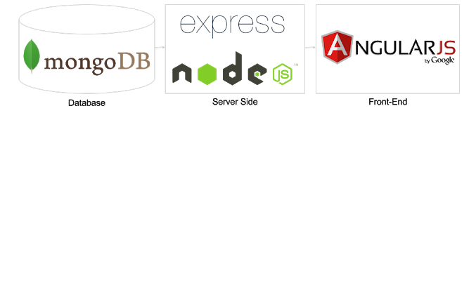
MODULE FOR ACADEMIC PROJECT
“Credentials, Profile Management for hiring sector and admin panel”

Slide 9
MODULE FOR ACADEMIC PROJECT
"Credentials, Profile Management for hiring sector and admin panel”
This project is developed using MEAN stack ,where MEAN is a collection of JavaScript-based technologies — MongoDB, Express.js, AngularJS, and Node.js — used to develop web applications. From the client and server sides to databases.
MEAN is a full-stack development toolkit.
AngularJS allows the application to have an expanded HTML library. Improved behavior to the HTML and speed up the application’s responsiveness.
Developing a website requires a strong backend so that there are no attempts to hack as well as a good server so that the site does not lag or crash during crucial moments. Angular handles all these requirements

Slide 10
MODULE FOR ACADEMIC PROJECT
“Credentials, Profile Management for hiring sector and admin panel”
This particular combination of tools has generated a lot of traction in the enterprise area and is framework based, making it a good place to start.
The key components are:
MongoDB (Database)
ExpressJS (Web Framework)
AngularJS (Front-end Framework)
NodeJS (Application Server)

Slide 11
Hardware System Configuration:-
SYSTEM REQUIREMENTS
Processor - Pentium to core i3
RAM - 1 GB
Hard Disk - 30 GB
Key Board - Standard Windows Keyboard
Mouse - Two or Three Button Mouse
Monitor – CRT or LED

Slide 12
SYSTEM REQUIREMENTS
Software System Configuration:-
Operating System : Windows 7
Front End : Angular 4
Script : Java Server Pages.
Database : MongoDB
Server : NodeJS

Slide 13
Modules in Employer Profile
Employer Details
Privacy Setting
Company Details
Profile
Service history
Report Generate
Credential settings

Slide 14
About Report Generation
Login Report
Database Report
Usage Report
OTP Report
SMS Report
Calling Report

Slide 15
Project Covered
Dashboard
Database Connectivity
Validation
Searching (partial)

Slide 16
Project Yet to be Done
Need to find Best Searching algorithm
Redundancy avoiding techniques
Work on Captcha
Admin panel
Some UI related work

Slide 17
Thank you

